Slide 1
MySQL Tutorial Day - 2

Slide 2
So far…
Installing XAMPP
Running MySQL
Creating Database
Creating Table
Inserting Row
Display / Select
Deleting Row

Slide 3
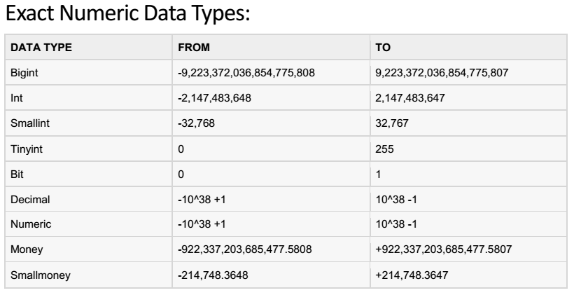
MySQL Data Types (Domain)

Slide 4
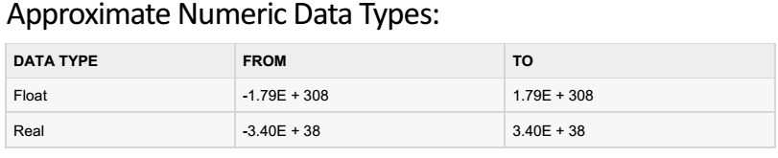
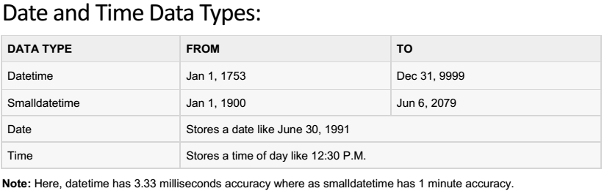
MySQL Data Types (Domain)

Slide 5
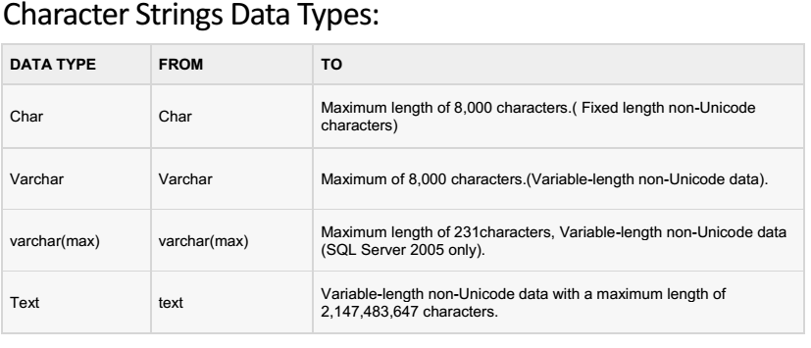
MySQL Data Types (Domain)

Slide 6
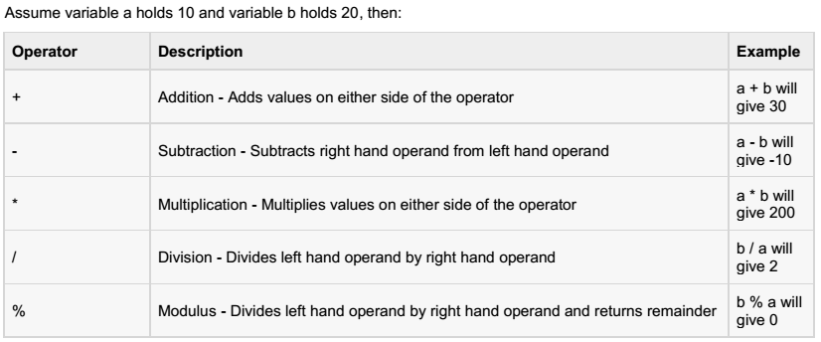
MySQL Arithmetic Operators

Slide 7
MySQL Comparison Operators
Operator | Description
= | Checks if the values of two operands are equal or not, true if equal
!= | Checks if the values of two operands are equal or not, true if not equal
<> | Checks if the values of two operands are equal or not, true if equal
> | If the value of left operand is greater than the value of right operand
< | If the value of left operand is less than the value of right operand
>= | If the value of left operand is greater than or equal to the value of right
<= | If the value of left operand is less than or equal to the value of right
!< | If the value of left operand is not less than the value of right operand
!> | If the value of left operand is not greater than the value of right operand

Slide 8
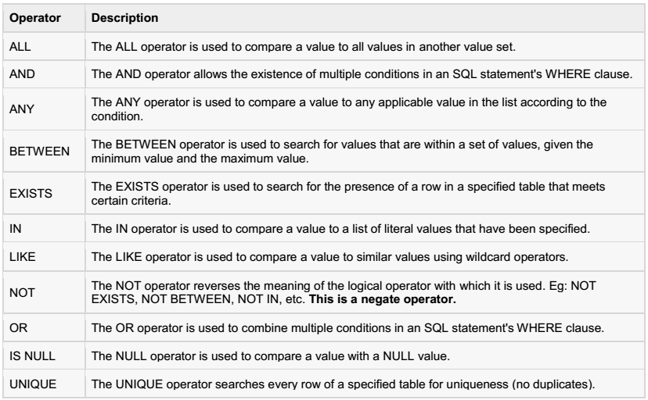
MySQL Logical Operators

Slide 9
UPDATE Query
UPDATE table_name SET column_name = value [column_name = value …. ] WHERE key = value;

Slide 10
ORDER BY Clause
SELECT * FROM table_name ORDER BY key_value;
For sorting order use ASC or DSC
Example: SELECT * FROM computers ORDER BY price DSC;

Slide 11
GROUP BY Clause
SELECT column_name, aggregate_function(column_name) FROM table_name WHERE column_name operator value GROUP BY column_name;

Slide 12
Save To Text File
Syntax: SELECT * FROM table_name INTO OUTFILE ‘directory_name+file_name’;
For new line: SELECT * FROM table_name INTO OUTFILE ‘directory_name+file_name’ LINES TERMINATED BY ‘\r\n’;

